Slide 1
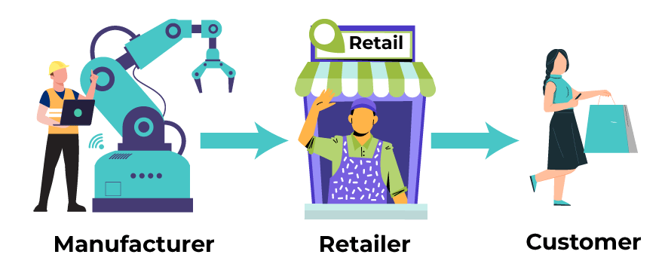
Challenge & Objective
In 2018, retail stores in the U.S. lost out $300 M because of poor inventory management. Half of them admitted that this happened because they weren’t aware of when to purchase, which product and at what quantity.
Consequences
Dissatisfied customers.
Decrease in sales and profits.
Unnecessary inventory holding costs.
Write-off inventory, and more.
Purchase
Sell
Inventory management

